Slide 1

Virtual Workout Buddy
Deep Learning with Tensorflow Class
4/12/2025

Slide 2
Title Slide
Project Name: Virtual Workout Buddy
Team Members:
Tony Lam
Tong Liu
Ziteng Wang
Van Lam
Tagline: Your AI-powered fitness coach for perfect form!
Logo:

Slide 3
Introduction
Purpose: "Created by fitness enthusiasts and AI experts to help people exercise safely and effectively."
Problem Statement:
Poor workout form → injuries, inefficient results.
Lack of access to personal trainers.
Solution: AI-driven real-time form analysis for everyone.

Slide 4
Mission & Vision
Mission Statement: "Make professional form analysis accessible to everyone, anywhere, anytime."
Core Belief: "Proper form is the foundation of any successful workout routine."
Vision: Democratize fitness coaching with AI.

Slide 5
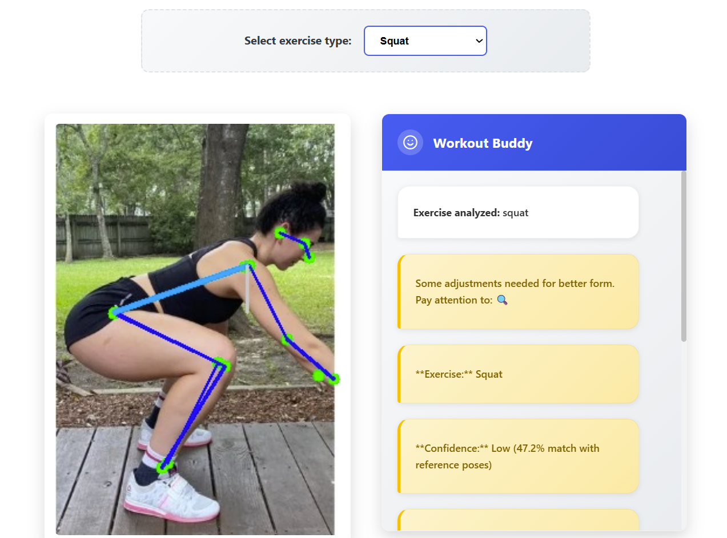
How It Works
Step 1: User uploads workout image/video.
Step 2: AI analyzes posture, joint angles, and movement.
Step 3: Instant feedback with corrections (e.g., "Lower your knees!").

Slide 6
Why Proper Form Matters
Benefits:
� Prevents injuries (e.g., back strain, joint stress).
💪 Maximizes results (targets right muscles).
📈 Long-term progress (builds good habits).

Slide 7
Technology Stack
AI/ML: Pose estimation model (Yolo v11).
Backend: Python, Flask/Django.
Frontend: HTML/CSS/JavaScript.

Slide 8
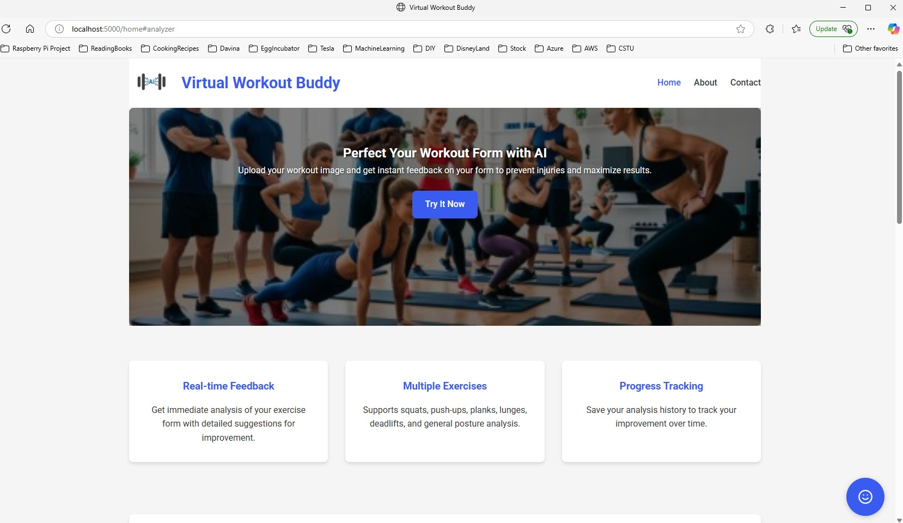
Website
Main page

Slide 9
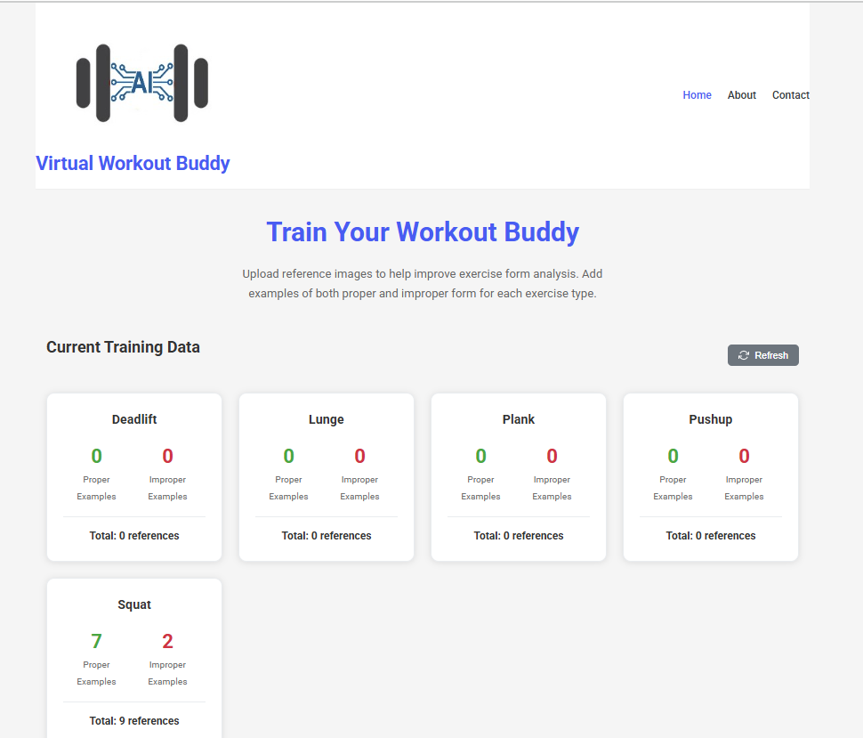
Website Admin
Training LLM Dashboard

Slide 10
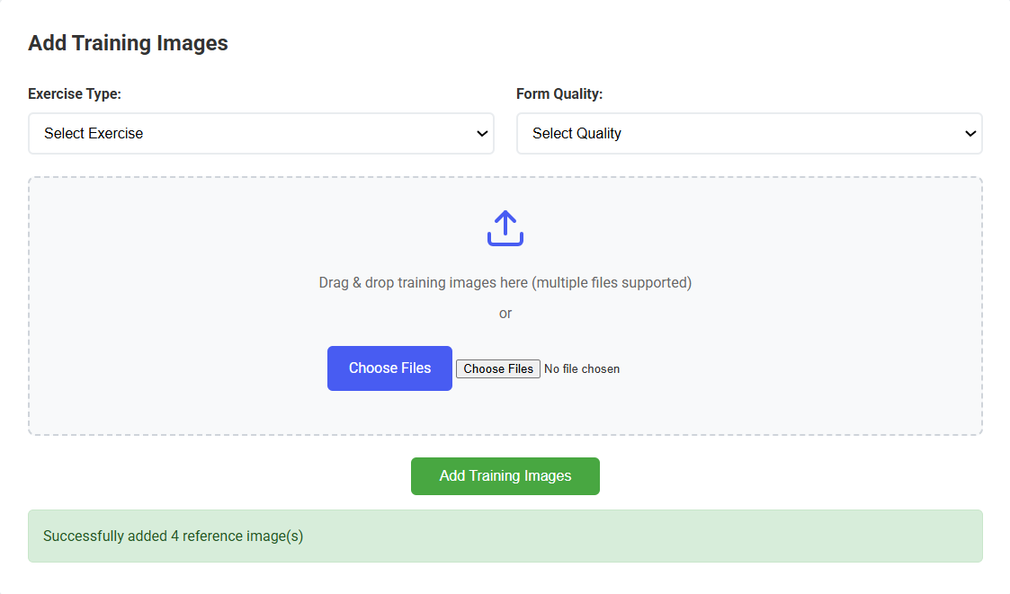
Website Admin
Train LLM with uploads

Slide 11
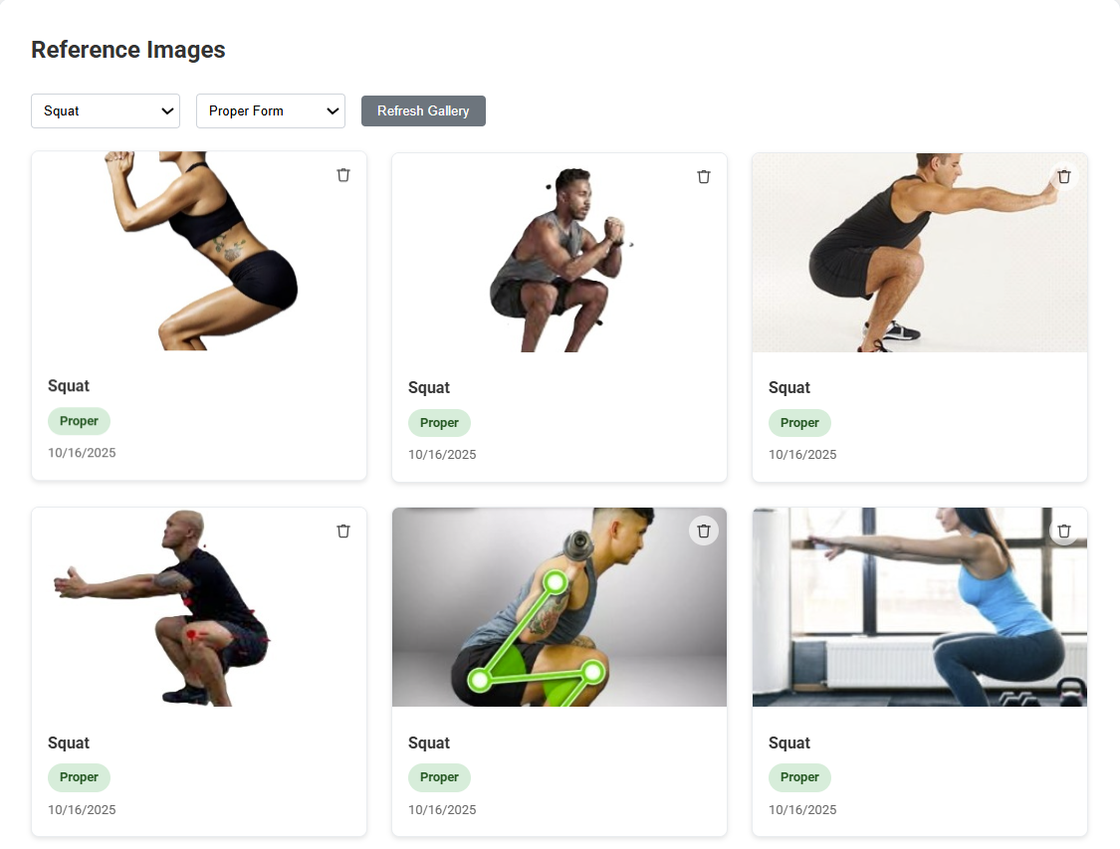
Website Admin (cont.)
Trained LLM
reference images
after upload

Slide 12
Future Roadmap
Plans:
Mobile app development.
Exercise library expansion.
Social features (share progress).

Slide 13
Q&A
"Thank you! Any questions?"

